Slide 1
Module 2
Symmetric Encryption Algorithms
Topic
Advanced Encryption Standard (AES)

Slide 2
Introduction - Advanced Encryption Standard
AES is a block cipher algorithm that can process a 128-bit block of plaintext at a time.
AES uses a large 128-bit key size to perform encryption and decryption process. AES increases the key size to 128 bits, 192 bits and 256 bits.
AES cipher uses 10 rounds of operation for performing encryption and decryption processes.
The number of rounds used in three versions of AES can differ.
EX: AES-128 - 10 rounds
AES-192 - 12 rounds
AES-256 - 14 rounds
In each round, AES performs substitution and permutation operations.
AES is not using Feistel structure and hence entire data block is processed in a parallel way during each round.

Slide 3
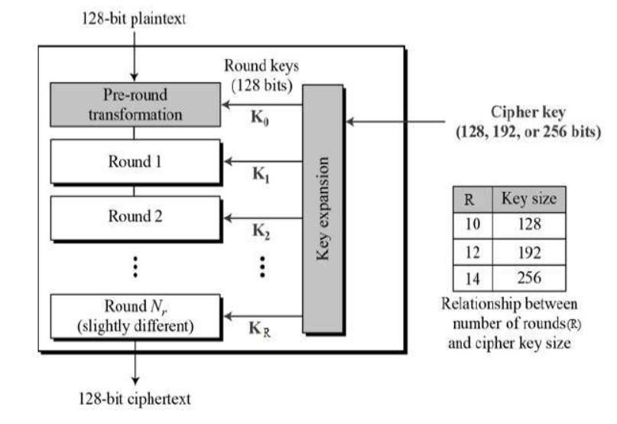


Slide 4
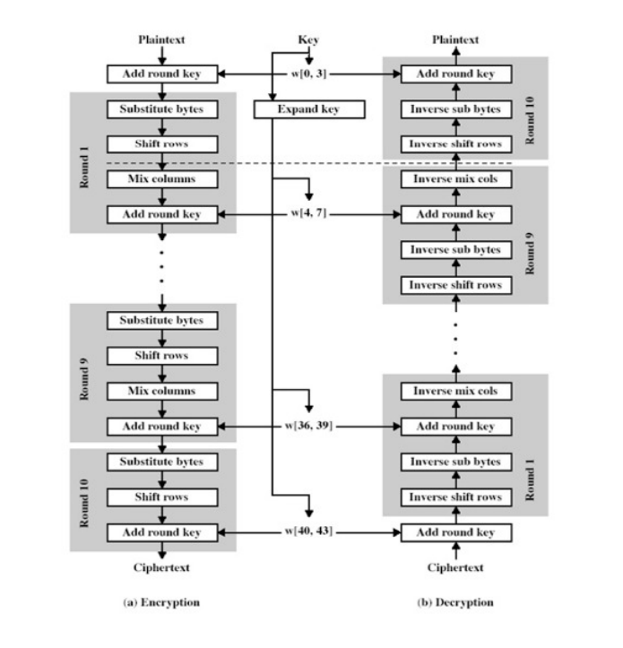

Slide 5
AES Encryption
To generate a ciphertext, the AES perform number of rounds of operation on the plaintext based on the key size.
In each round, it performs 4 transformations
      SubBytes
      ShiftRows
      MixColumns
      AddRoundKey
SubBytes and MixColumns are used to perform simple substitution operation.
ShiftRows is used to perform the permutation operation.
AddRoundKey is used to perform the XOR operation in the encryption and decryption process.

Slide 6
AES Decryption
Similar to the substitution and transposition performed in the encryption process, there are inverse transformations in the decryption process.
The inverse transformations are
    InvSubBytes
    InvShiftRows
    InvMixColumns
    AddRoundKey

Slide 7
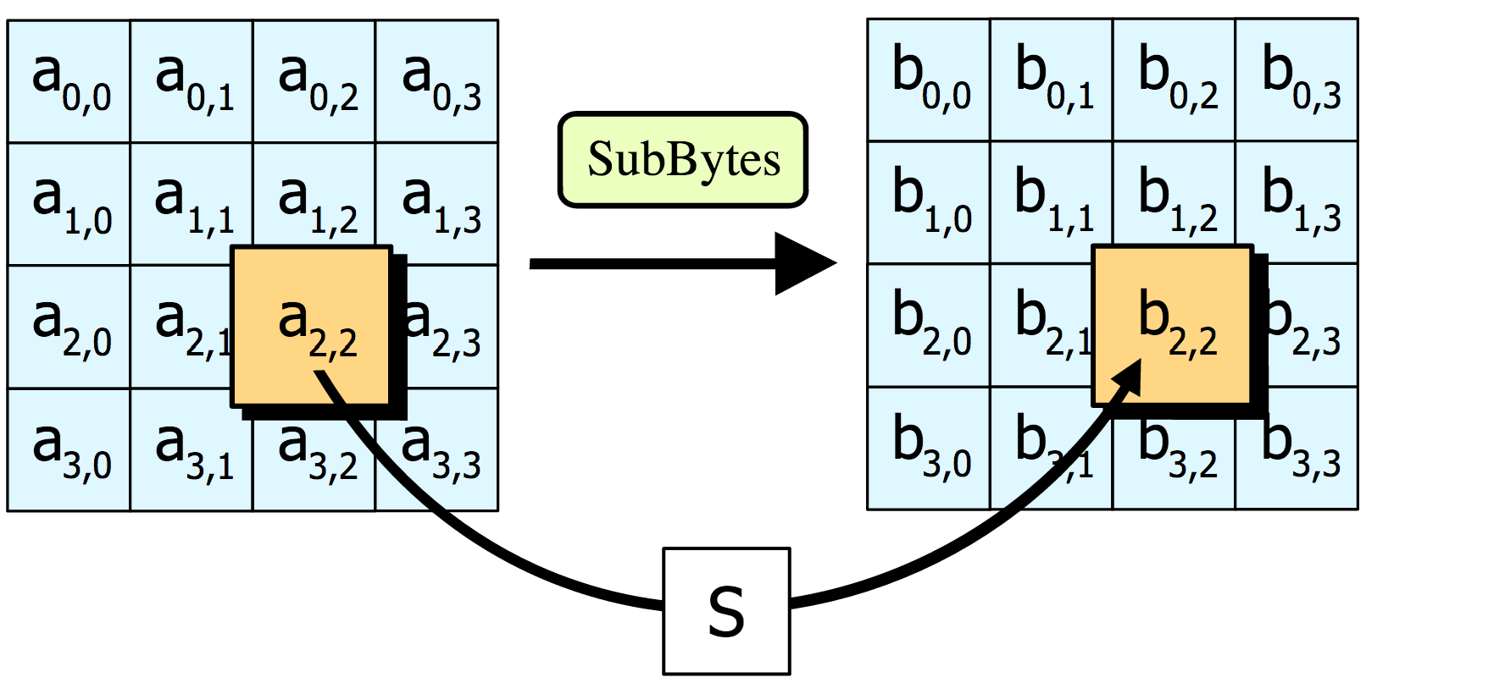
SubBytes
The first transformation used at the encryption side is called subBytes.
The given 128 bit block is represented as a (4 × 4) square matrix that consists of 16 cells.
In each cell, one byte of the plaintext is placed.
The first four bytes are placed in the first column and the second four bytes are placed in the second column and so on.
Each element of the matrix is replaced by the an element of s-box matrix.

Slide 8
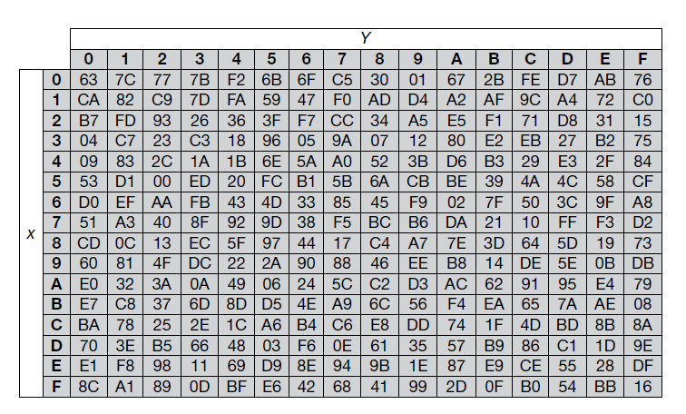
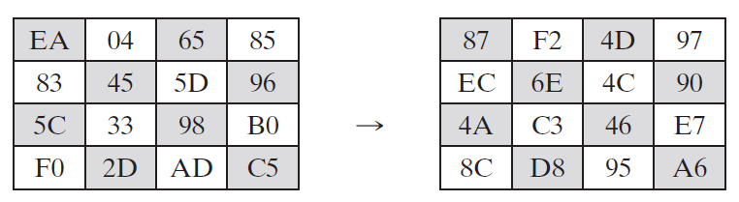
For example: if the input to the S-box is 75, then it will select the value which is located in the 7th row and 5th column which contains the value 9D.
S-box
S-Box

Slide 9
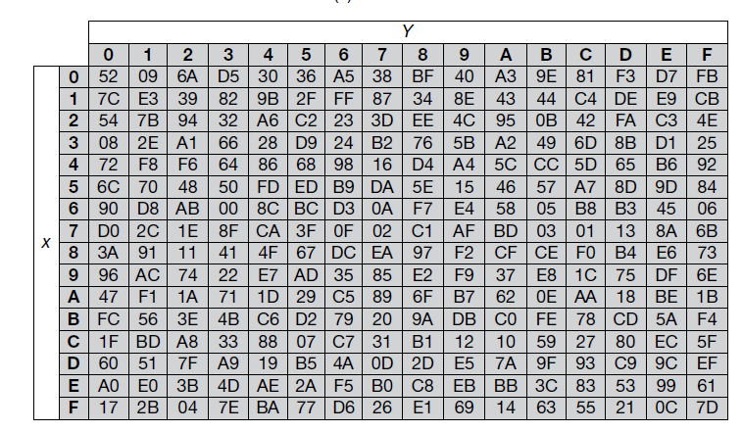
InvSubBytes
Inverse S-box
InvSubBytes is the inverse of SubBytes.
For example: During the decryption process, the hexadecimal value 9D is used to select the value 75 from the inverse S-box defined for decryption process.

Slide 10
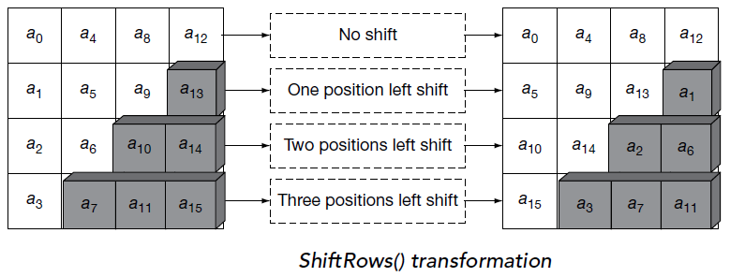
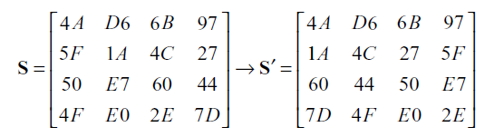
ShiftRows
The first row of input/State is not altered.
For the second row, a 1-byte circular left shift is performed.
For the third row, a 2-byte circular left shift is performed.
For the fourth row, a 3-byte circular left shift is performed.

Slide 11
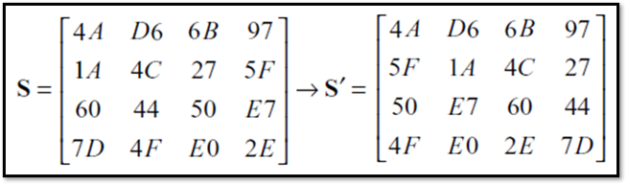
InverseShiftRows
The first row of input/State is not altered.
For the second row, a 1-byte circular right shift is performed.
For the third row, a 2-byte circular right shift is performed.
For the fourth row, a 3-byte circular right shift is performed.

Slide 12
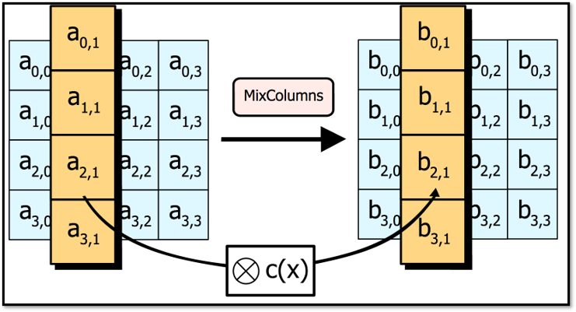
MixColumns
Each column is operated on individually in the Mixcolumns() transformation.
The transformation can be determined by performing a matrix multiplication based on GF(2⁸) with respect to a matrix defined for Mixcolumns() transformation.
AES) uses the characteristic 2 finite field with 128 elements, which can also be called the Galois field GF(2⁸). It employs the following reducing polynomial for multiplication: x⁸ + x⁷ …. x³ + x + 1.

Slide 13
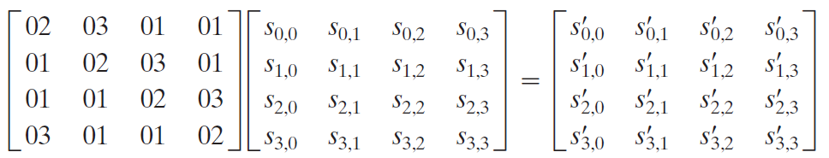
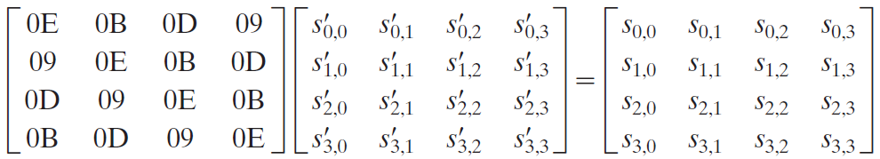
Mix Columns
Inverse Mix Columns

Slide 14
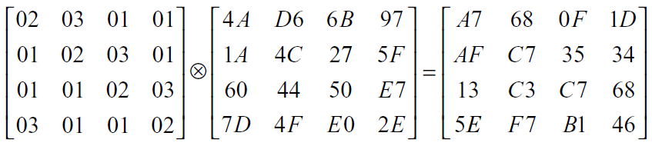
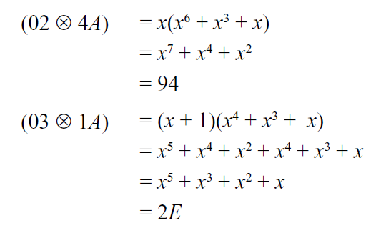
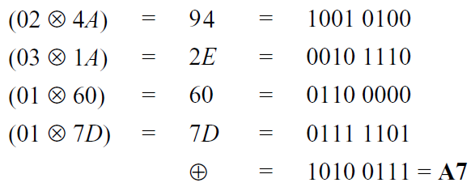
Example of Mix columns

Slide 15
Calculation of 02 X 4A
GF (2⁸) = x⁷+x⁶+x⁵+x⁴+x³+x²+x+1
02 X 4A
0000 0010 X 0100 1010
x (x⁶+x³+x)
x⁷+x⁴+x²
1001 0100
94

Slide 16
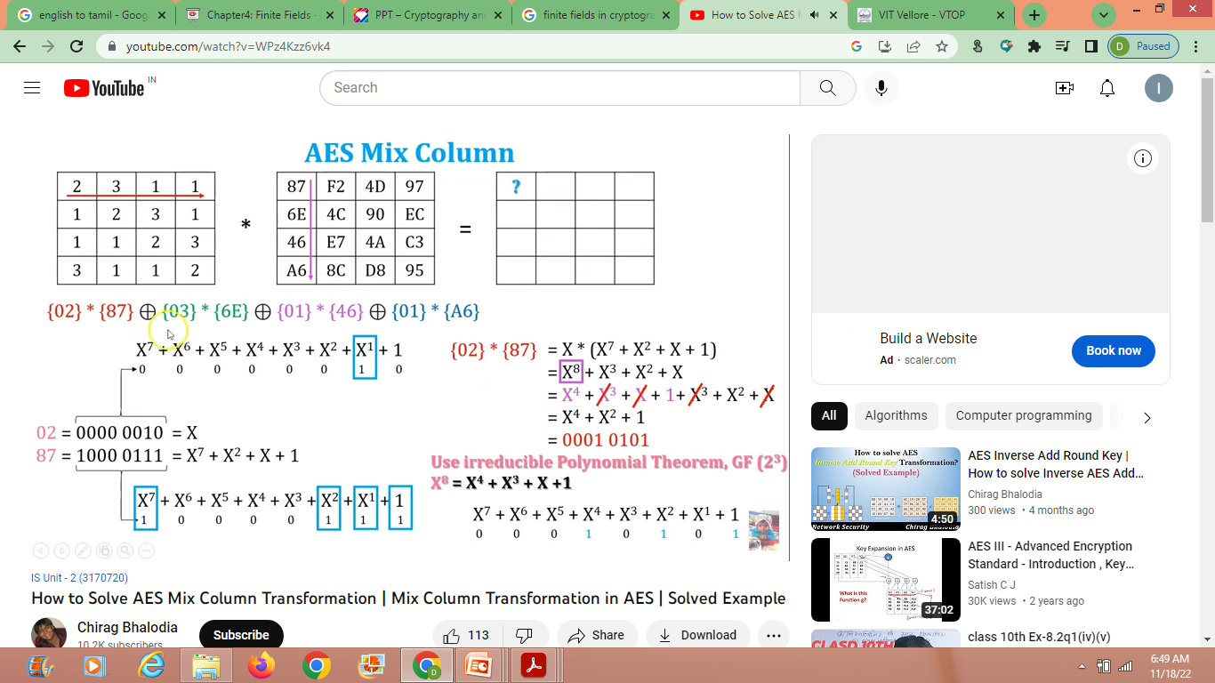
Example for X⁸

Slide 17
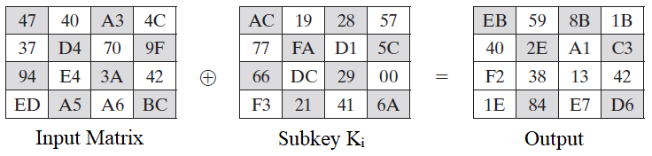
AddRoundKey
In Addroundkey() transformation, the output produced by the mixcolumn() transformation is XOR-ed with the subkey value produced by the key expansion algorithm.

Slide 18
Key Expansion
A 128-bit key, the key is arranged in the form of an array of 4 × 4 bytes.
Each column of 4 bytes represented as one word. Similarly, 4 word forms one round key.
For a 128-bit encryption algorithm, the total number of keys required is 10 sub key+1 original key=11.
Each key should have the key length of 128 bits (4 words).

Slide 19
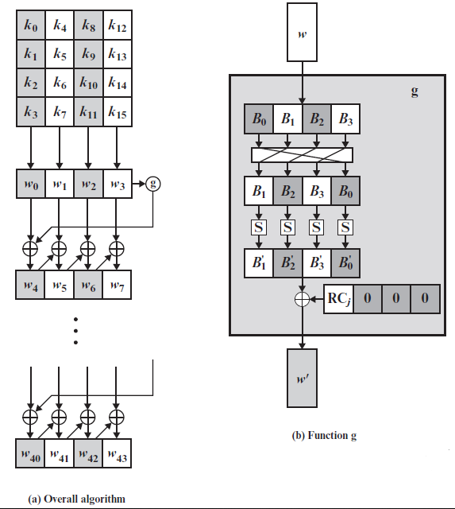
W0 W1 W2 W3 – Master Key
W4 W5 W6 W7 – Round 1 Key
W4=w0⊕g(w3)
W5=w1⊕w4
W6=w2⊕w5
W7=w3⊕w6

Slide 20

Function g consists:
RotWord performs a one-byte circular left shift on a word.
SubWord performs a byte substitution on each byte of its input word, using the S-box.
The result of steps 1 and 2 is XORed with a round constant, Rcon[j].
  The round constant is a word in which the three rightmost bytes are always 0.
Rcon [1] = 01 00 00 00

Slide 21
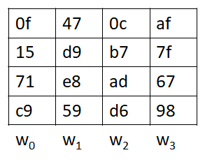
Example
The main key also act as key K₀ for encryption and will be directly used for pre-round computation.
Key for Round1:
W4=w0⊕g(w3)
W5=w1⊕w4
W6=w2⊕w5
W7=w3⊕w6
Main key K
Before perform XoR operation we need to find g(w3)

Slide 22
g(w₃) = g(af 7f 67 98)
RotWord:
af 7f 67 98 = 7f 67 98 af
SubWord:
7f 67 98 af = d2 85 46 79
Rcon(1) = 01 00 00 00 (we are finding a subkey for round 1)
g(w₃) = SubWord XOR Rcon(1)
= (d2 85 46 79) XOR (01 00 00 00)
g(w₃)= d3 85 46 79
W₄=w₀⊕g(w₃)
= (0f 15 71 c9) ⊕ (d3 85 46 79) = dc 90 37 b0
W₅=w₁⊕w₄
= (47 d9 e8 59) ⊕ (dc 90 37 b0) = 9b 49 df e9
W₆=w₂⊕w₅
= (0c b7 ad d6) ⊕ (9b 49 df e9) = 97 fe 72 3f
W7=w3⊕w6
= (af 7f 67 98) ⊕ (97 fe 72 3f) = 38 81 15 a7

